Slide 1



Slide 2
TAP Debrief
We did it!!!!,-
Tomorrow morning I will post the Set Analysis on the TAP Information page under "TAP Materials))
The Set Analysis is the output you must use for your Psychobiology report
You MUST NOT use the output from your own TAP!
Important
The numbers and output on the Set Analysis WILL BE DIFFERENT than what you produced for the TAP.
DO NOT PANIC!
2

Slide 3
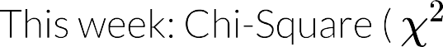

Slide 4

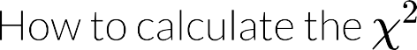


Slide 5

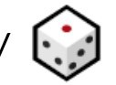
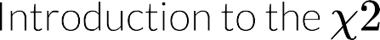


Slide 6

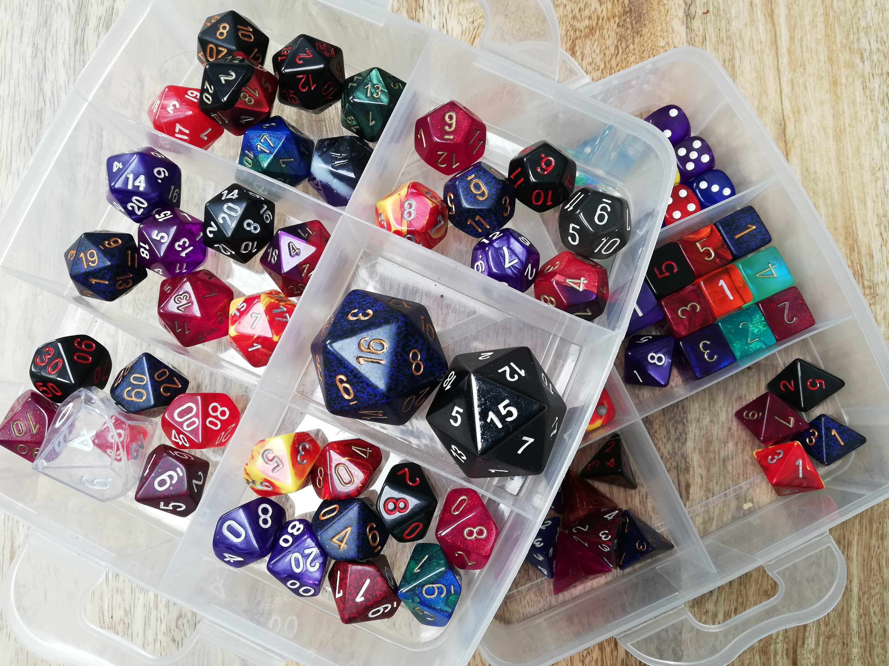

Slide 8
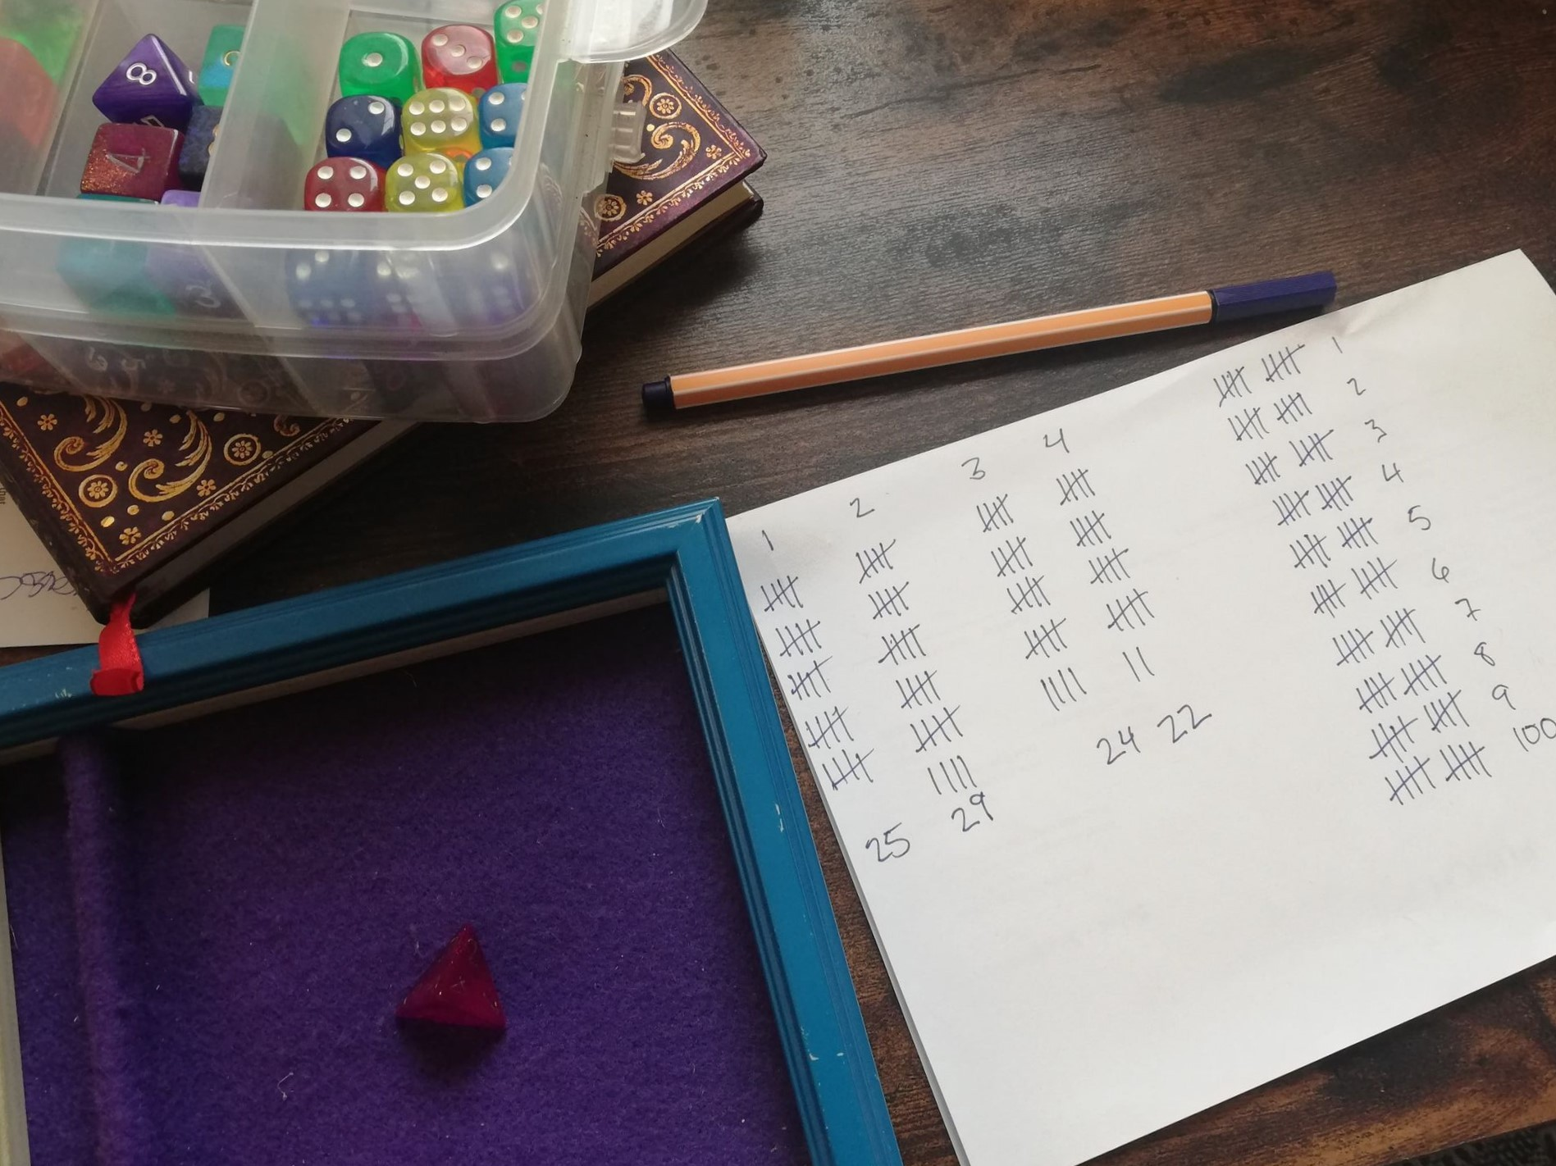

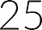
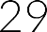
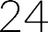
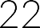

Slide 9
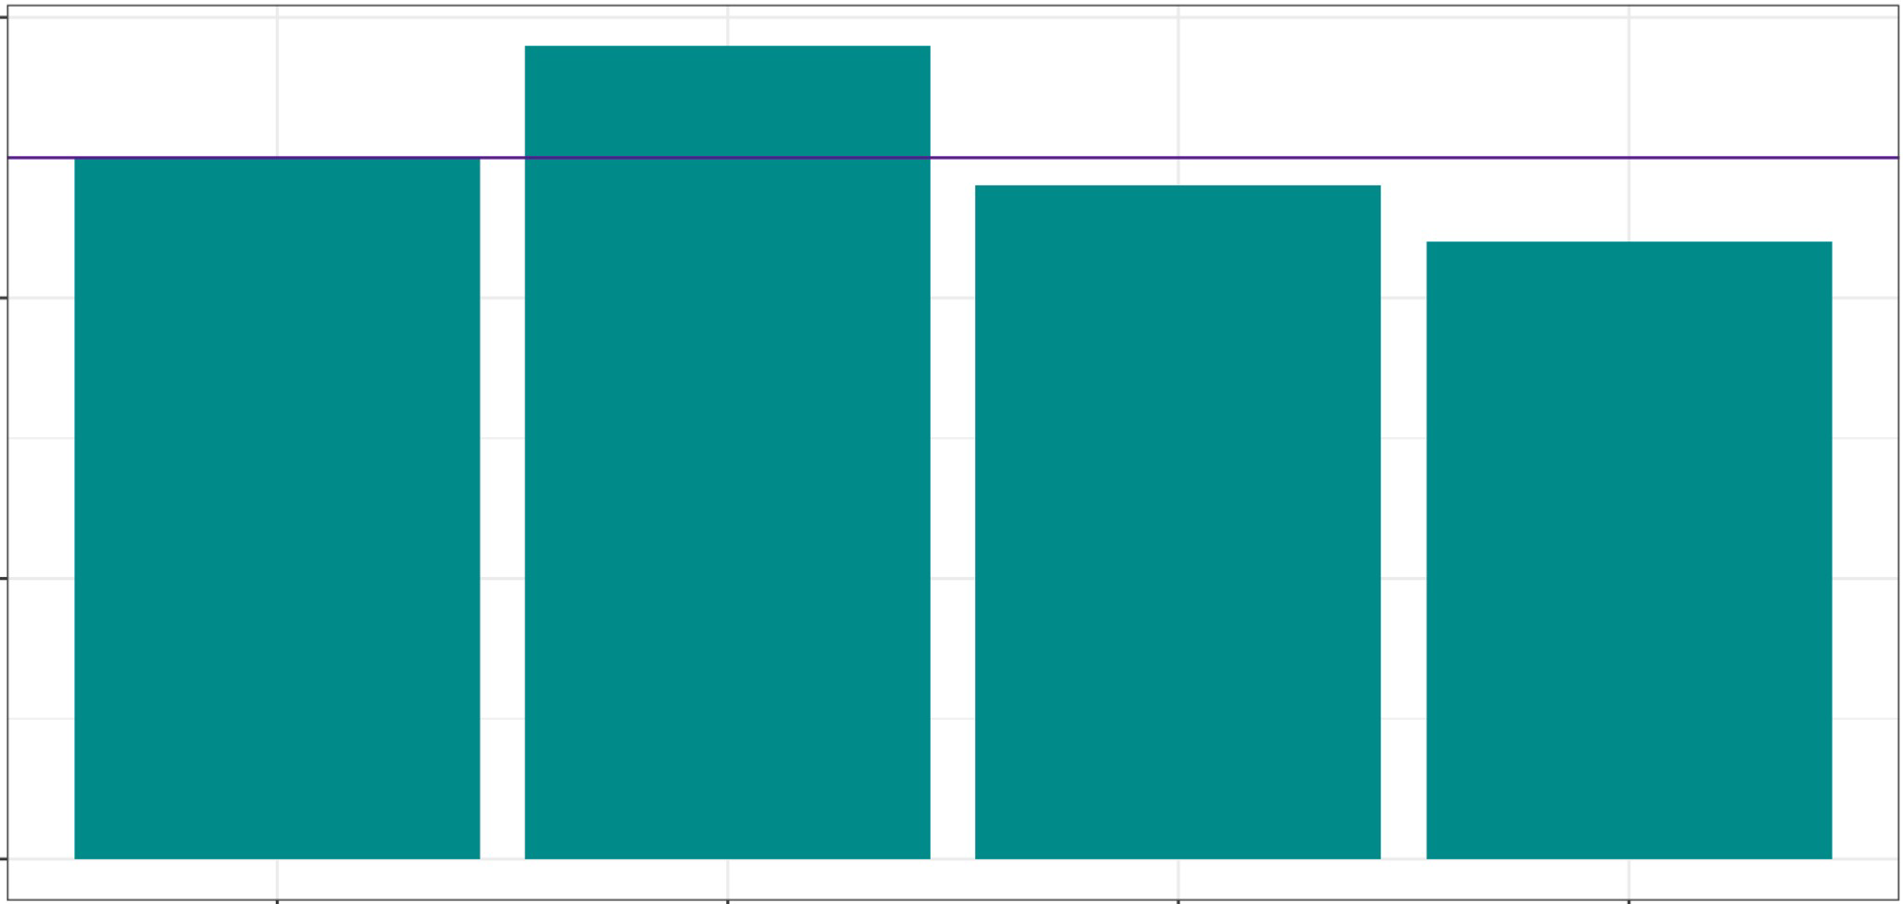
A Fair Shake?
30
These numbers are not
exactly 25 each
But we live in a random universe!
20
c
::,
0 (.)
10
0
2
Die Roll
3
4
The Fundamental Question
Are these proportions what we would expect if the die were fair? Are they different enough to believe the die is not fair?
9

Slide 10




Slide 11
Calculate a Test Statistic
How different are the observed counts from the expected counts?
Dice Roll | Obs. Count | Exp. Count | Difference
1 | 25 | 25 | 0
2 | 29 | 25 | 4
3 | 24 | 25 | -1
4 | 22 | 25 | -3
(25-25)²+
(29-25) +
2
(24-25)²
(22-25)²
x2
+
25
25
25
25
0 16
1 9
x2
25 + 25 + 25 + 25
x² == o + o.64 + o.o4 + o.36
x² == 1.04
Vocabulary: Observed counts
The number of occurrences in each category observed in the sample.
Vocabulary: Expected counts
The number of occurrences in each category expected under the null hypothesis.
Vocabulary: x²
The test statistic x² represents the sum of the squared (and scaled) differences between observed and expected counts.
11

Slide 12
Compare to the Distribution
We}ve calculated a test statistic, x², that represents the thing we are trying to test
Here: the scaled squared difference between expected and observed counts
More generally: a single number representing how much the rolls we observed differed from what we would expect from a perfectly fair die
Important
Is this test statistic (x² = 1.04) big or small in the grand scheme of things?
Compare our test statistic to the distribution of that statistic
IMPORTANT:These distributions assume that the null hypothesis is true!
Here, our null hypothesis is that the die IS fair
12

Slide 13



χ

Slide 14
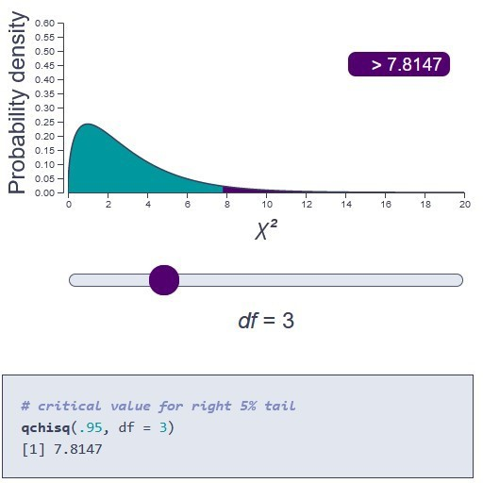


χ

Slide 15


Slide 16
Detour: Degrees of Freedom
Week of Term | Quiz Score | Rolling Mean
Week3 | 4.5 | 4.5
Week4 | 2.5 | 3.5
Week5 | 2.75 | 3.25
Week6 | 4.75 | 3.62
Week8 | 4 | 3.7
Week9 | 5 | 3.92
Week 10 | 3.5 | 3.86
The last value must have a particular value in order to work out to the desired mean
4.5 + 2.5 + 2.75 + 4.75 + 4 + 5 + 3.5+??? ==
8
4
Here, df = 7
One less than the number of scores
Other degrees of freedom have a similar idea,just calculated differently
Week 11
???
???
Important
You do NOT need to know how to calculate degrees of freedom!
You must know how to report it from the output, and have some idea of what it does.
16

Slide 17


Slide 18
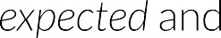

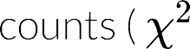
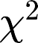



Slide 19

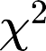


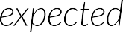


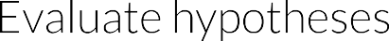

Slide 20
Morex²
We just saw a goodness of f,t test
Vocabulary: x² Goodness of Fit Test
Tests whether a sample of frequency data came from a population with a specific, known distribution.
Next, lef s look at a test of association, or independence
Are two categorical variables associated or not?
20

Slide 21
Quick Refresher: Variable Types
Vocabulary: Continuous data
Represent some measurement or score on a scale.
Examples: Reaction time to press a button, mean anxiety scor
Answers the question: how much?
Vocabulary: Categorical data
Represent membership in a particular group or condition. Examples: control vs experimental group, year of uni
Answers the question: which one?
21

Slide 22

χ

Slide 23
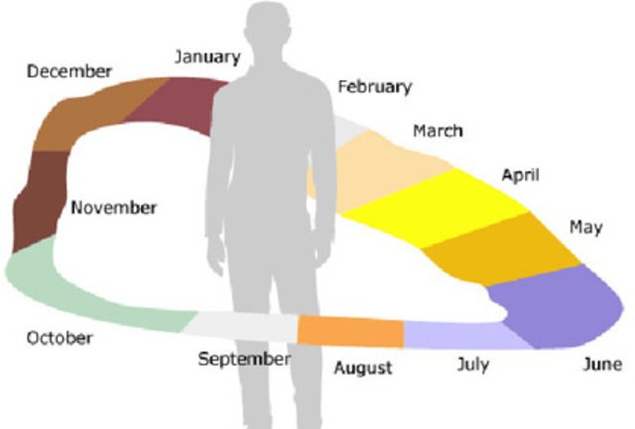


Slide 24
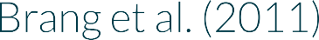




Slide 25



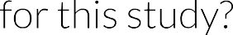

Slide 26
Let's Think About This...
Alternative hypothesis
Clockwise and anticlockwise calendar orientations will occur in different proportions in left- and right-handed syanesthetes Slight rephrase: Calendar orientation is associated with synaesthete handedness
Null hypothesis
Both calendar orientations will occur in equal proportions in left- and right-handed syanesthetes Slight rephrase: Calendar orientation is not associated with synaesthete handedness
Prediction
From the Brang et al. paper:
Right-handed synaesthetes will tend to have a clockwise calendar
Left-handed synaesthetes will tend to have an anticlockwise calendar
26

Slide 27

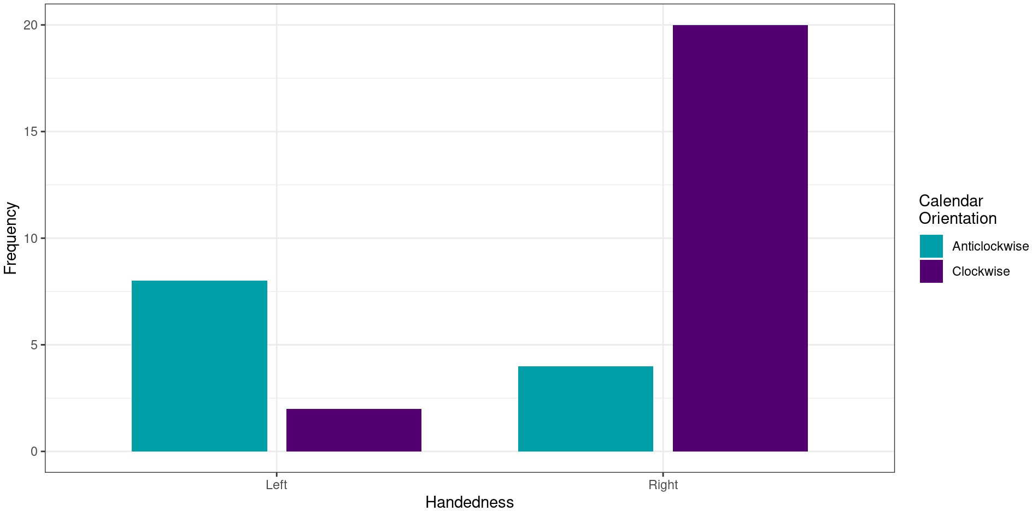



Slide 28
Test Result
Do our results indicate that there may be an association between orientation and handedness?
Pearson's Chi-squared test with Yates' continuity correction
data: seq_space$orientation and seq_space$handedness X-squared = 9.7798, df = 1, p-value = 0.001764
Interpretation
What can you conclude from this result?
28

Slide 29
Test Result
Do our results indicate that there may be an association between orientation and handedness?
Pearson's Chi-squared test with Yates' continuity correction
data: seq_space$orientation and seq_space$handedness X-squared = 9.7798, df = 1, p-value = 0.001764
Interpretation
"There was a significant association between calendar orientation and handedness ( x²(1) = 9.78, p = .002):'
29

Slide 30


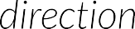


Slide 31

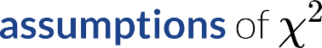






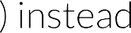

Slide 32
A Portent of Things To Come
We have just had our first glimpse of statistical assumptions
A huge and complex topic...for next year! !!,-
Vocabulary: Statistical Assumption
A precondition that must be true in order for a statistical test to work as expected. If these assumptions are violated (i.e. not true), then the test may give inaccurate or misleading estimates or results.
32

Slide 33



